Slide 1


Real Estate Investment & California Price Prediction
Thip Rattanavilay
Bellevue University / dsc-680

Slide 2

PROBLEM TO BE SOLVED
HIGH MARKET PRICE
MEDIAN HOUSEHOLD INCOME
AFFORABLE HOUSINGING
INVESTMENTS opportunity

Slide 3

THE DATA

Slide 4

Data processing with two files (CA housing and Zillow)
Houses sold in 2016 ( Zillow Transaction data) - 90k Properties. California averaged more than 200,000 new homes annually, with multifamily housing accounting for more of the housing production.
Properties data– 27 Million Properties (58 attributes)
Mortgage Records Attached
Tax Assessments
Physical features of the Property(Bed Count , Living Area, Age of the building)
Location Details about the properties
Amenities available in the property

Slide 5

METHOD & APPROACH
DATA UNDERSTANDING / EDA
DATA PREPARATION
MODELING
EVALUATION
DEPLOYMENT
BUSINESS UNDERSTANDING

Slide 6

Exploratory Data Analysis

Slide 7
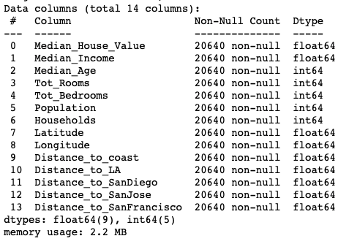
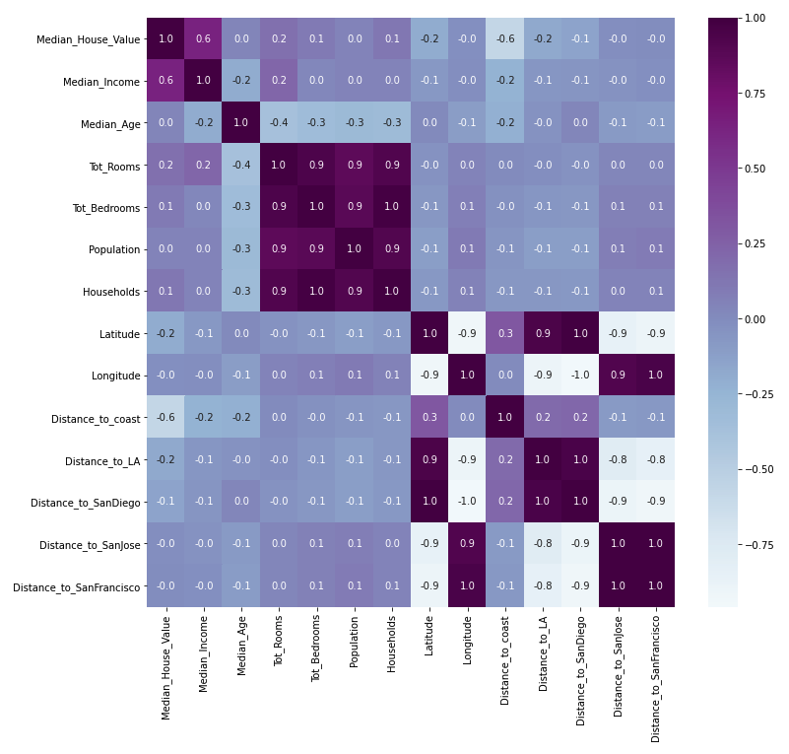
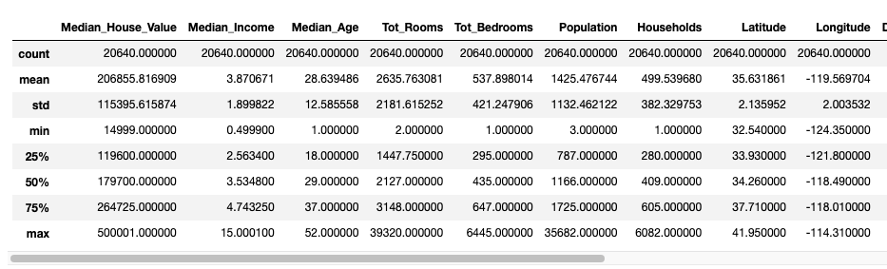
Notes:
After parsing through the initial data set, we can see there are 20640 entries and 14 data columns. All data represents a block within a neighborhood. The heatmap of a correlation table with new data frame

Slide 8

Missing Values & Duplications

Slide 9
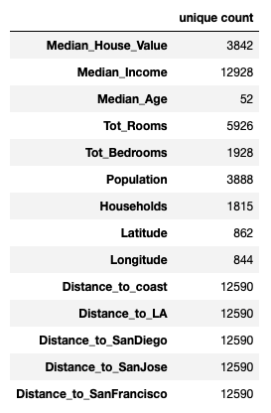
Let's dive into the data and look for unique values to ensure there are no duplicates or missing values.

Slide 10

Feature Engineering and Feature selection

Slide 11
The target variable is Median_House_Value
Dataset - California_Houses
Median_House_Value
Median_Income
Median_Age
Tot_Rooms
Tot_Bedrooms
Population
Households
Latitude
Longitude
Distance_to_coast
Distance_to_SanDiego
Distance_to_SanJose
Distance_to_SanFrancisco
Dataset – Zillow_California
- UnemploymentRate
MedianMortageRate
MedianMortageRate
MedianSoldPrice_AllHomes.California
Notes:
After parsing through the initial data set, we can see there are 20640 entries and 14 data columns. All data represents a block within a neighborhood. The heatmap of a correlation table with new data frame

Slide 12

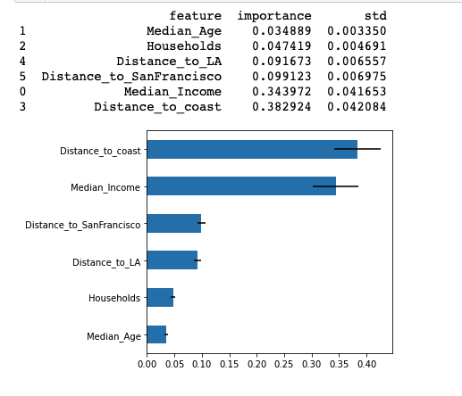
Used the following techniques
Multiple Linear Regression
Regression Tree Mode
Random Forest
Lasso Regression
Ridge Regression

Slide 13

Modeling

Slide 14

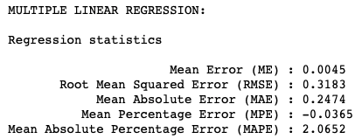
Multiple Linear Regression

Slide 15
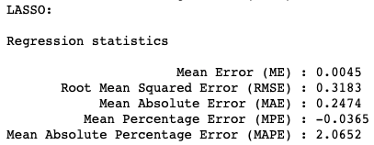
Lasso Regression

Slide 16
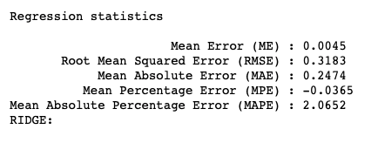
Ridge Regression

Slide 17
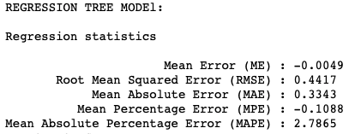
Regression Tree

Slide 18
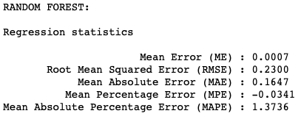
Random Forest

Slide 19
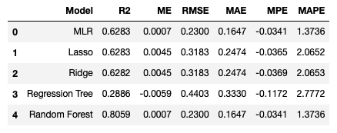
Summary Metrics Table of Each Model

Slide 20
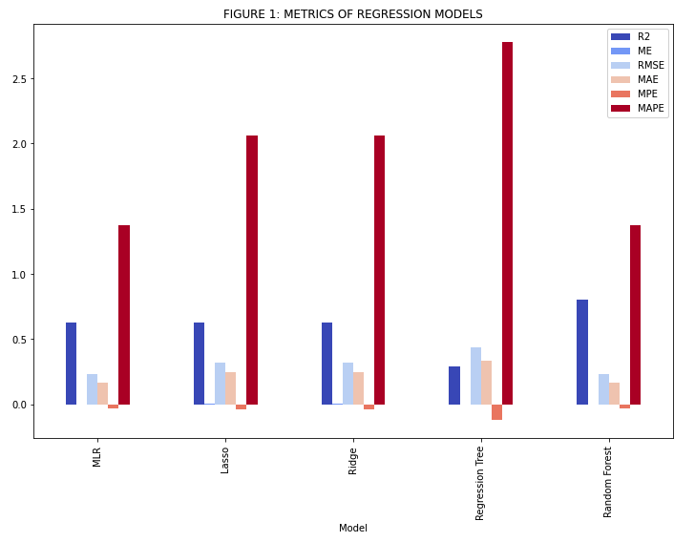

Slide 21
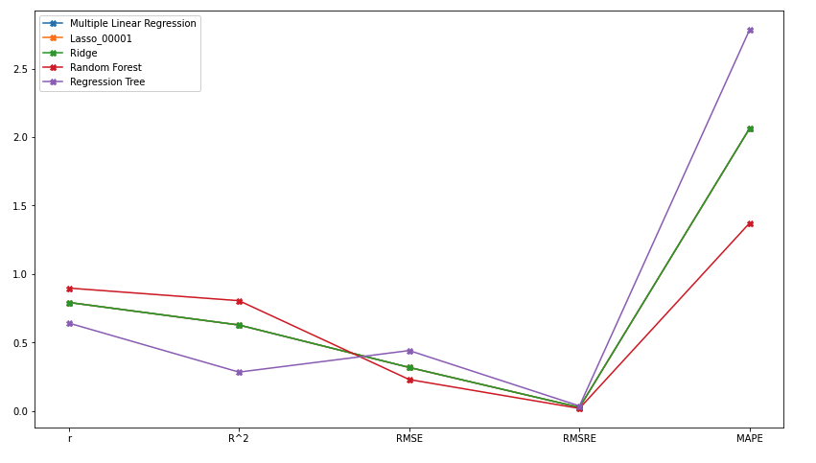

Slide 22

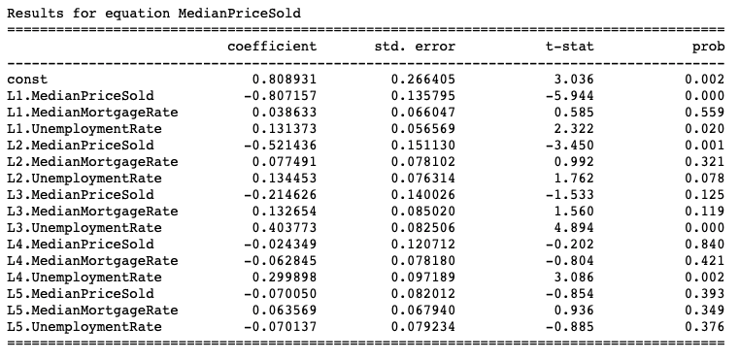
Results for equation MedianPriceSold

Slide 23
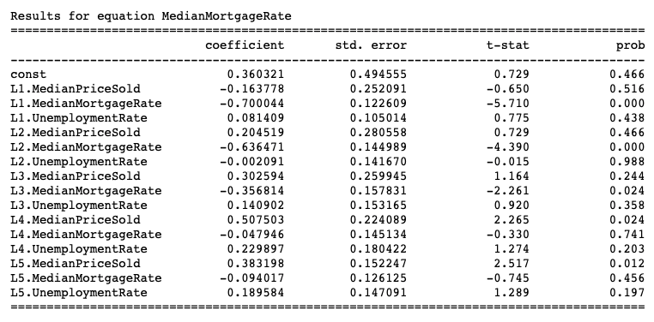
Results for equation MedianMortgageRate

Slide 24
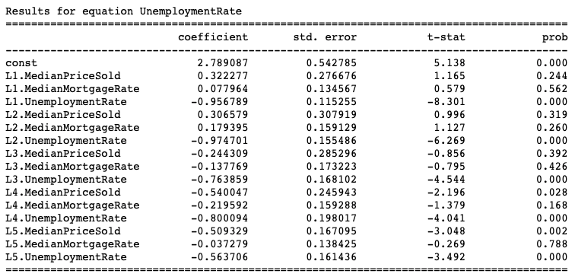
Results for equation UnemploymentRate

Slide 25
Correlation matrix of residuals
 | MedianPriceSold | MedianMortgageRate | UnemploymentRate
MedianPriceSold | 1.000000 | - 0.072780 | 0.289204
MedianMortgageRate | -0.072780 | 1.000000 | 0.250494
UnemploymentRate | 0.289204 | 0.250494 | 1.000000

Slide 26
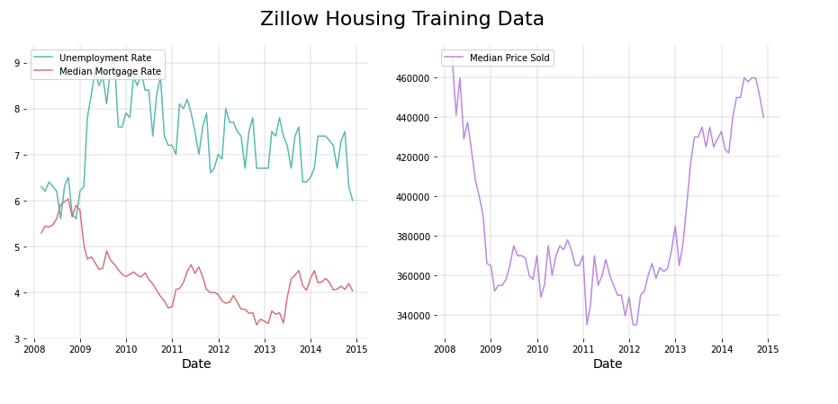

Slide 27
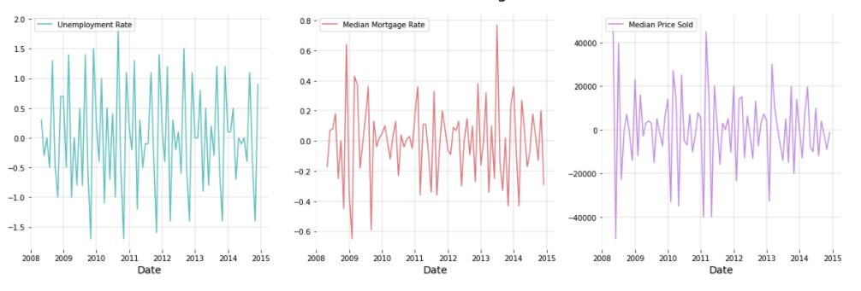

Slide 28

Fine Tune
Careful inspection of null values
Ensemble learning outperforms a single model
Minimizing the categorical attribute levels

Slide 29

RANDOM FOREST PERFORMED THE BEST
Random Forest scored the highest R2 value of 80.59% best fitting the data set. Thus, Random Forest deemed the best model for the prediction of California house prices.

Slide 30

Investment in California

Slide 31

California Housing Market Remains Solid

Slide 32
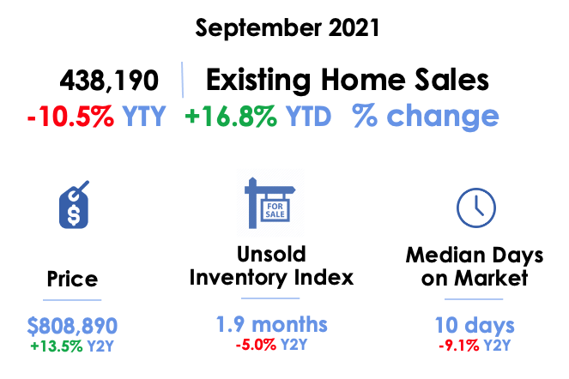

Slide 33

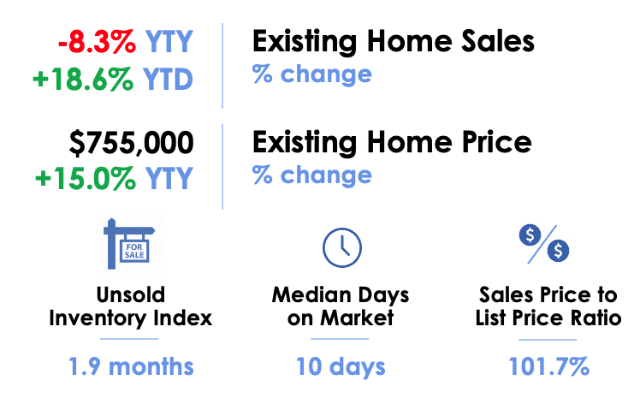
September 2021 Southern California Housing

Slide 34
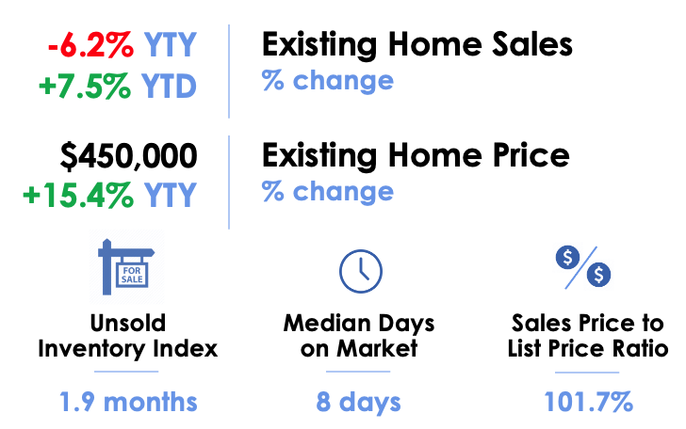
September 2021 Central California Housing

Slide 35
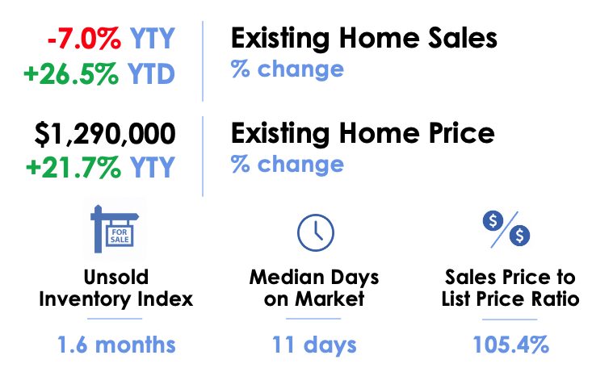
September 2021 Bay Area California Housing

Slide 36
California Housing Market Sales

Slide 37
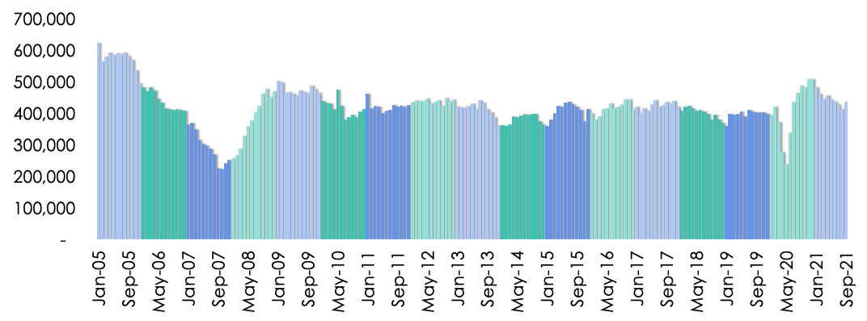

Slide 38
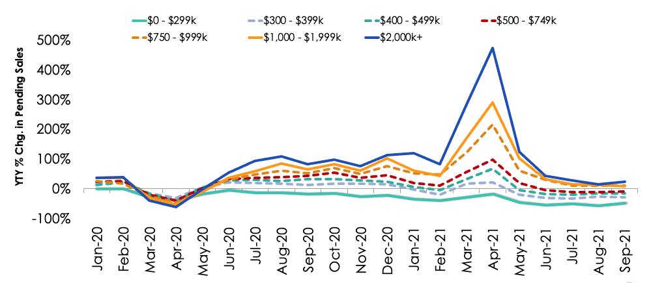

Slide 39
California Housing Market Price

Slide 40
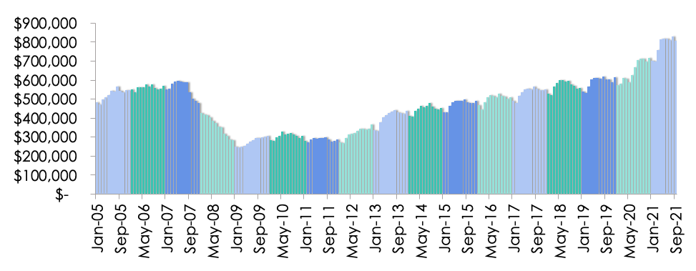

Slide 41

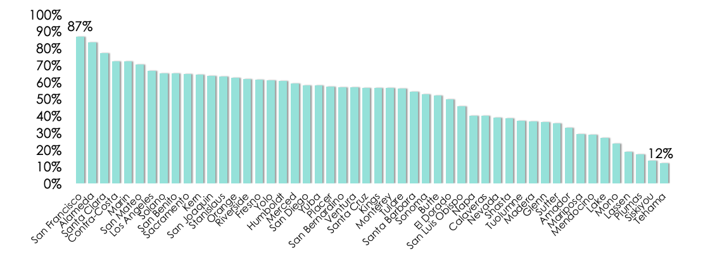

Slide 42
Should Investors or Home buyer Invest in California Housing Market?

Slide 43


The Answer is …

Slide 44

Save your money!
The data shows that the housing market in California is way too high and that your mortgage and interest rate will be too high to manage, and you’ll end up filling for bankruptcy. For those seeking to invest stay far way from California as possible.

Slide 45

THANK YOU!

Slide 46

References

